Slide 1


SPECIFICATION
SERVICES
SPECIFICATIONS
TYPES OF
SPECIFICATIONS
WELCOME TO
SPECIFICATION
SERVICES
TOOLS AND
REFERENCE
MATERIAL
SPECIFICATION
WRITING
AMBIGUITY
RULES AND
WRITING TIPS
USING DIPL
WORKSECTION
TEMPLATES

Slide 2



SPECIFICATION SERVICES
AIM OF THIS SESSION
  An introduction of who we are.
  An overview of what services we provide.
  To help you with your specification writing skills.

Slide 3











SPECIFICATION SERVICES
WHO WE ARE
LAWRENCE
FOSCARO
JOBELLE
RODRIGUEZ
(MATERNITY LEAVE)
  TONY
  McLEAN
ROBERT
HAAKMEESTER
NIGEL
KNIBBS
SPIROS
LAMBRINIDIS
VICTORIA
JENKINS
KAYLEEN
YUEN

Slide 4

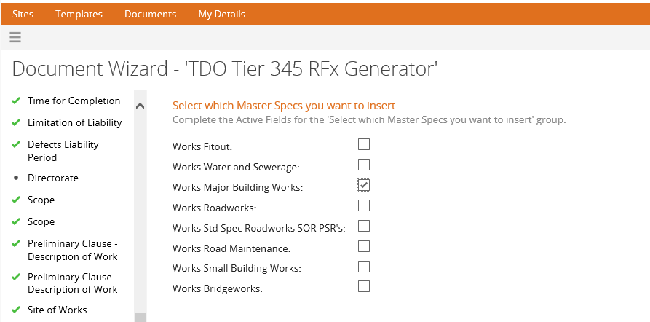
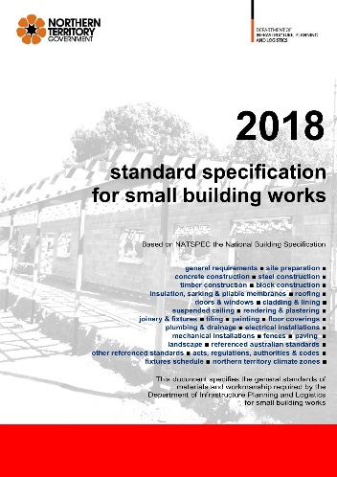
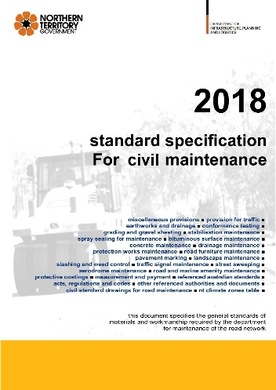

SPECIFICATION SERVICES
WHAT WE DO
Specification Services maintain a series of specifications used in the preparation of contract documents for the construction and maintenance of government infrastructure.
The specifications cover:
  Buildings.
  Roads and other civil works.
  Environmental management.
  Some technical content located in the Preliminary clauses.

Slide 5
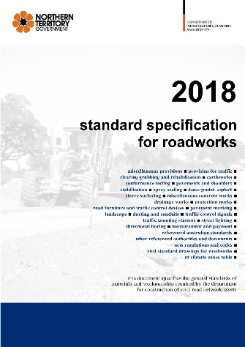
SPECIFICATION SERVICES
RECENT UPDATES:
STANDARD SPECIFICATION ROADWORKS REFERENCE BOOK
22 technical worksections. Version 4.0 is now available for download.
Overview of Updates are available from the Roads webpage, Specifications and supplementary documents heading.
https://dipl.nt.gov.au/infrastructure/technical-standards-guidelines-and-specifications/technical-specifications/roads
Some significant changes include:
Miscellaneous Provisions:
  Volatile Substances Management - Hold Point. New clause making contractors aware of the NT Government Volatile Substance Abuse Prevention Act introduced in 2006 to prevent substance abuse and protect individuals and communities from harm.
  Permits to Access Land for Works on Roads - Hold Point. New clause asking for documentary evidence of having been granted approvals and permission to enter privately controlled land.

Slide 6
SPECIFICATION SERVICES
RECENT UPDATES:
STANDARD SPECIFICATION ROADWORKS REFERENCE BOOK
Provision For Traffic:
  Ownership markings on temporary traffic control signs and devices. New clause on marking requirements on the backs of signs. Advertising markings are not permitted.
  Clean Up of Tracked Materials. New clause to remove tracked materials such as dirt, mud, and other detritus, from the work zone immediately.
  Signs and Devices Not In Use. New clause not leave signs and devices in the Work zone if they are not in use.
  Reinstatement of Signs and Devices. New clause to check all signage and devices after any severe weather event and to reinstate them.
  Traffic Management Plan. Significant changes. New clause for Document control.
  Traffic Management Audit Requirements. New clause referencing Panel Period Audit Consultants.
  Conformance Auditing Results. New clause.
  Night Illumination. New clause.
  Variable Speed Limit Zones. New clause.

Slide 7
SPECIFICATION SERVICES
RECENT UPDATES:
STANDARD SPECIFICATION ROADWORKS REFERENCE BOOK
Pavements and Shoulders:
  Significant changes.
Stabilisation and Modification:
  Significant changes.
Spray Sealing:
  Self-Propelled Rubber Tyred Vibrating Rollers. New clause.
Road Furniture and Traffic Control Devices:
  Tactile Ground Surface Indicators - Witness Point. New clause.
  Anti-spear fixings for hazard markers (sight boards). New clause.
  Road Safety Barriers - Steel Wire Rope System - Hold Point. New clause.
Pavement Marking:
  Significant changes.
Landscape:
  Batter Protection by Hydroseeding. New clause referencing an erosion control Engineered Fibre Matrix (EFM) product.

Slide 8
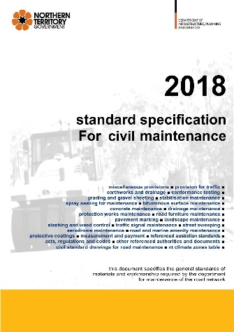
SPECIFICATION SERVICES
RECENT UPDATES:
STANDARD SPECIFICATION CIVIL MAINTENANCE REFERENCE BOOK
Formerly Standard Specification for Road Maintenance.
22 technical worksections
New worksections as of 2019
  Bus Stop Maintenance.
  Street Lighting Maintenance (Proposed).
A significant change has been made to the Aerodrome Maintenance worksection in reference to Aerodrome Reporting Officers (ARO’s).

Slide 9
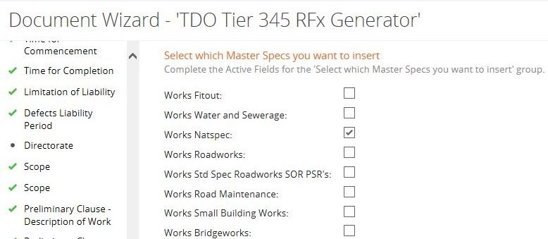
SPECIFICATION SERVICES
RECENT UPDATES:
MAJOR BUILDING WORKS SPECIFICATION
65 technical worksections
All Major Building Works worksections have undergone a major review. Overview of Updates are available from the Buildings webpage.
https://dipl.nt.gov.au/infrastructure/technical-standards-guidelines-and-specifications/technical-specifications/buildings
New worksections as of 2018-2019:
  Photovoltaic.
  Uninterrupted Power Supply.
  Generators.
  Liquid Fuels.
  Mechanical Systems.
  Mechanical Air Coils.
  Chillers Combined.
  Cooling Towers.
Ductwork Insulation.
Mechanical pipework Insulation.
Water Treatment.
Building Management System.
Mechanical Commissioning.
Mechanical Maintenance.
Civil Works.

Slide 10
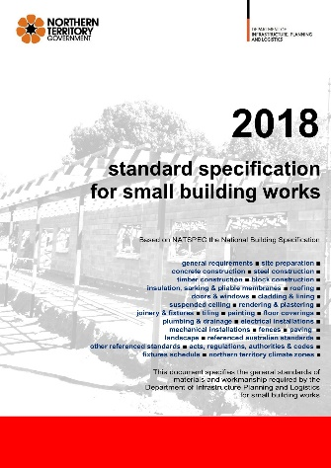

SPECIFICATION SERVICES
RECENT UPDATES:
STANDARD SPECIFICATION SMALL BUILDING WORKS REFERENCE BOOK
23 technical worksections. Updates starting late 2019.
New worksections as of 2018
  Fabric Shade Structures.
STANDARD SPECIFICATION FOR ENVIRONMENTAL MANAGEMENT
The Standard Specification for Environmental Management has undergone a major review.
Version 2.0 is now available for download.
https://transport.nt.gov.au/infrastructure/technical-standards-guidelines-and-specifications/technical-specifications/environmental-management

Slide 11
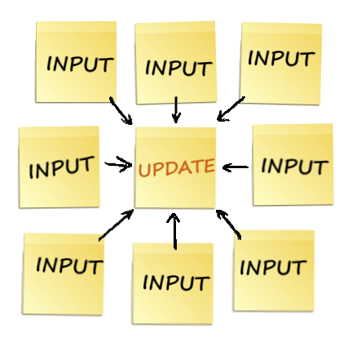
SPECIFICATION SERVICES
LOOKING AHEAD
Specification Services are looking to host a series of specifications used in the preparation of contract documents for the construction of government infrastructure.
The hosted specifications cover:
  Housing.
  Subdivisions.
  Civil Works National Harmonization (Austroads).
Specifications are edited to contain the latest updates in policy and regional requirements. They ensure that assets constructed for the NTG reflect best industry practice.
Input from front line staff is essential for our documents to represent best practice for our Territory.

Slide 12

SPECIFICATION SERVICES
WHAT WE DO
Functions and services of the unit include:
  Review of Specifications (RFT’s / RFQ’s).
  Development and maintenance of specification templates and reference documents.
  Publishing of standard specifications reference text books.
  Development and maintenance of guides and supporting documents for staff, consultants, contractors, and tenderers.
  Training in specification writing.
Manage subscriptions:
  NATSPEC.
  Australian Paint Approval Scheme (APAS).
  Australian Standards.

Slide 13







SPECIFICATION SERVICES
WHAT WE DO
Liaise with:
  Regions.
  Australian Building Codes Board (ABCB).
  Australian Institute of Architects (AIA).
  Australian Road Research Board (ARRB).
  Austroads.
  Civil Contractors Federation NT (CCFNT).
  NATSPEC.
  Standards Australia.
  Other Stakeholders.

Slide 14

SPECIFICATION SERVICES
WHAT WE DO NOT DO
Advice on Tender Documents Online (TDO).
Technical support for TDO.
For TDO training and assistance, TDO tools, and
technical difficulties and errors, please
contact Procurement Operations and Delivery.
Email: procurementadvice.dipl@nt.gov.au
Phone: 08 8924 7254

Slide 15



SPECIFICATIONS
WHY HAVE A SPECIFICATION
The primary function of the drawings and specification is to give effect to design decisions. There are many design decisions which cannot be expressed in drawn form. These must rely on being expressed in words.
The specification is created to complement, without duplication, the drawings. Together they convey all the design decisions.

Slide 16
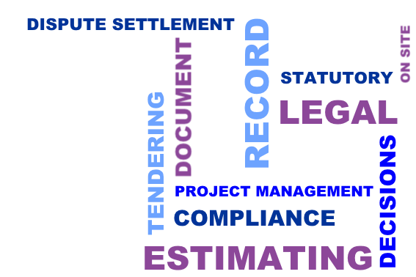
SPECIFICATIONS
THE ROLES OF THE SPECIFICATION
The specification has many roles:
  A written record of design decisions taken.
  A document demonstrating compliance with statutory requirements.
  An estimating document.
  A tendering document.
  A legal (contractual) document.
  An on-site working document.
  A dispute settlement document.
  A project management tool.
  A facilities management tool.

Slide 17

SPECIFICATIONS
SPECIFICATION USERS
It is important to ensure all users interpret the specification in the same way. A good specification is clear, concise and easily understood. Users include:
  Designers.
  Clients.
  Certifying authorities.
  Estimators.
  Tenderers.
  Contractors and subcontractors.
  Contract administrators.
  Legal representatives.
  Project managers.
  Construction managers.
  Facilities managers.

Slide 18

SPECIFICATIONS
USING SPECIFICATIONS TO DEFINE QUALITY
Quality must be defined. It cannot be managed if it is not defined. Quality can have different meanings for different people in different situations.
In construction this problem is amplified because the responsibility for a project is divided between many different people, within many organisations.
Therefore, agreement on a defined quality level between all parties, and how it is to be measured, is key to achieving the desired quality to the satisfaction of the Principal.
Communicating the requirements for quality is the main technical function of the specification.

Slide 19


SPECIFICATIONS
USING DIPL WORKSECTION TEMPLATES TO ACHIEVE QUALITY
All worksection templates include the construction processes required for each particular item of work. They define clear industry standard acceptance criteria in the form of:
  Tolerances.
  Performance.
  Testing and Certification.
Modify the worksection templates to suit the defined quality levels for each project and its components.

Slide 20

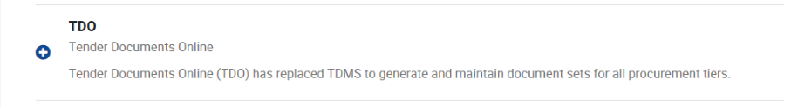
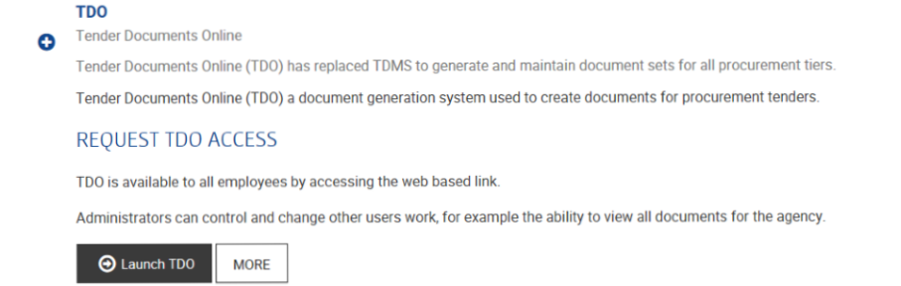
SPECIFICATIONS
LAUNCHING TDO

Slide 21

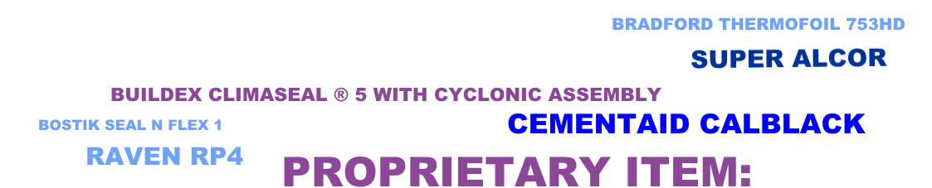
TYPES OF SPECIFICATIONS
REFERENCE
An identifiable printed and published document is incorporated by reference to it. These may be Australian Standards or manufacturer’s technical manuals. The DIPL published books are used as a reference specification in some of our contracts.
PERFORMANCE
Describing a desired end result and its acceptability.
DESCRIPTIVE
Detailing the materials, workmanship and installation requirements.
PROPRIETARY
Naming a proprietary trade name product.

Slide 22
TYPES OF SPECIFICATIONS
PROPRIETARY ITEM DEFINITION
Identification of a proprietary item does not imply exclusive preference for the item identified. It indicates the necessary properties of the item.
If alternatives are proposed, sufficient information needs to be submitted to permit evaluation of the proposed alternatives including the following:
  Evidence that the performance is equal to or greater than that specified.
  Evidence of conformity to a cited standard.
  Samples.
  Essential technical information, in English.
  Reasons for the proposed substitutions.
  Statement of the extent of revisions to the contract documents.
  Statement of the extent of revisions to the construction program.
  Statement of cost implications including costs outside the contract.
  Statement of consequent alterations to other parts of the works.
  There is a clause on Substitutions in the Conditions of Contract. All proposed substitutions need to be approved by the Superintendent

Slide 23
TYPES OF SPECIFICATIONS
insulation, Sarking, and Pliable Membranes
  Materials and Components
    Sarking-type material including vapour barriers
To AS/NZS 4200.1. Standards Mark required.
Proprietary Item: Bradford Thermofoil 753HD or Fletcher Metal Roof HD 453.
Where Sarking also forms a vapour barrier, the material must also be classified VCM Class 1 to AS/NZS 4200.1
Flammability index < 5 when tested in conformance with AS 1530.2.
Thermal performance labelling: To AS/NZS 4859.1 Reflective Insulation section.
Material must be classified as Water Barrier (AS/NZS 4200.1).
REFERENCE PERFORMANCE DESCRIPTIVE PROPRIETARY

Slide 24
TYPES OF SPECIFICATIONS
Suspended Ceilings
  Construction Generally
    Ceiling grid – Hold Point
Main tees at 600 mm centres unless noted otherwise.
Set out the ceiling grid so that panel joints and centrelines of visible suspension members coincide with grid lines if shown on the drawings. If not otherwise shown, set out so that opposite margins are equal. Use solid tiles around perimeter.
Follow manufacturer’s installation guidelines and manuals.
Hold Point - Obtain approval of the set out before commencing the installation.
REFERENCE PERFORMANCE DESCRIPTIVE PROPRIETARY

Slide 25
TYPES OF SPECIFICATIONS
Road Furniture and Traffic Control Devices
  Guide Posts
    General
Use THERMOPLASTIC guide posts manufactured from plastic alloy ASA/PC or similar.
Refer to Civil Standard Drawing CS 3500.
Posts to conform to the following:
Colour: Opaque white.
Finish: Smooth, glossy.
Length: 1380 mm.
Width: 95 mm minimum, 105 mm maximum, width to be constant to within 1 mm.
Web thickness: 3 mm minimum, 5 mm maximum.
REFERENCE PERFORMANCE DESCRIPTIVE PROPRIETARY

Slide 26
TYPES OF SPECIFICATIONS
Earthworks
  Fill material
    General fill
Use the best locally available material. Use fill material, whether cut or borrow, that is free of organic matter and has a minimum soaked CBR at 95% MMDD of 20%, to AS 1289, and a plasticity index between 2% and 15%.
REFERENCE PERFORMANCE DESCRIPTIVE PROPRIETARY

Slide 27


SPECIFICATION WRITING
IMPERATIVE MOOD STYLE
Address the Specification to the Contractor in the direct instruction style; imperative mood of the verb; second person, singular; subject suppressed.
The Imperative mood style is adopted as policy by Masterspec (USA), NBS (UK), CSC (Canada) and NATSPEC (Australia and New Zealand).
For example:
  Supply and Install. not You shall Supply and Install.
  Lay tiles. not Tiles shall be laid.
  Provide light fittings. not The contractor shall provide light fittings.
The active verb is usually the first word in each sentence. The words “the Contractor shall” are usually made redundant, by putting the verb in the Imperative mood.
Using the imperative mood results in specifications that are shorter, crisper, and easier to understand.

Slide 28

SPECIFICATION WRITING
REPETITION
Avoid repetition within the specification and between the specification, drawings and other contract documents. Say everything, but say it only once.
STRUCTURE
Break long clauses into subclauses, paragraphs, and subparagraphs with titles or bullet points.
Standardise text of common clauses and subclauses.
PLAIN LANGUAGE
Everyday language is easily understood by both the Layman and the Specialist. Use familiar and precise words and terms.
Avoid un-necessary words. Clearly convey the meaning, and avoid using Legal or Commercial phrases.

Slide 29
SPECIFICATION WRITING
CURRENCY
To be effective, project specifications should reflect current requirements and practices.
The best way of making sure a new specification is up-to-date is to use the latest worksection template available through Tender Documents Online (TDO).

Slide 30
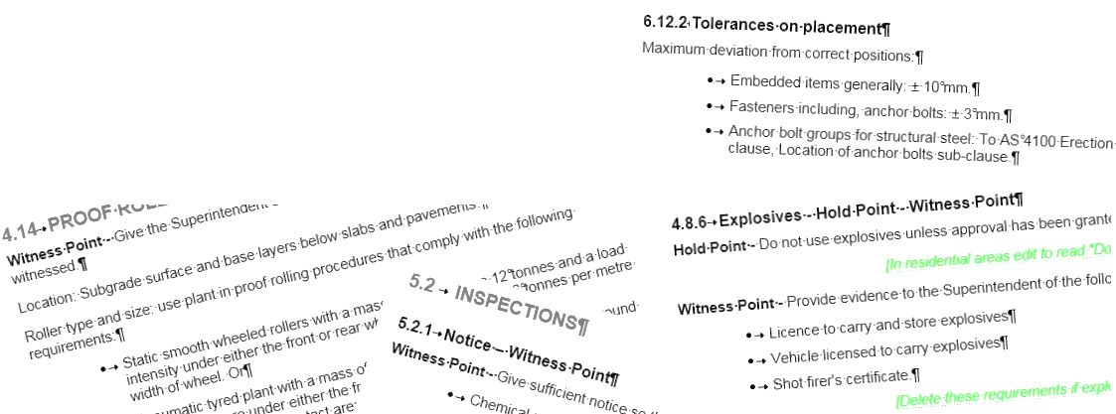
SPECIFICATION WRITING
LISTS
Where several items need to be itemised within a single paragraph, the items should be in Bullet style.
The styles in Word in TDO include a heading for bullets. These are set back from the margin (indented).
For example:
Spread Topsoil to the following typical depths:
  Planting areas: 300 mm.
  Irrigated grassed areas generally: 150 mm.

Slide 31
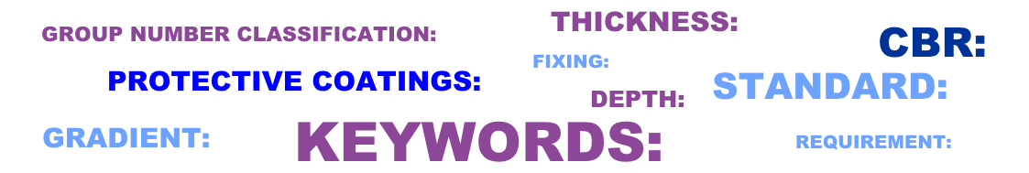
SPECIFICATION WRITING
KEY WORDS
A key word followed by a colon ( : ) readily identifies the content of a paragraph. This allows the faster scanning of the text by the reader. Key words may also be used to make reference to an Australian Standard.
For example:
Cement: to AS 3972, type GP.
TABLES
Keep tables in the portrait or upright format and keep the complete table on one page (when possible). If a table overruns the page, repeat the table headings on the following page.

Slide 32

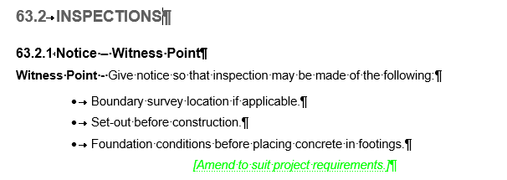

USING DIPL WORKSECTION TEMPLATES
Worksection templates are for use with projects of many types and sizes. They will not contain all the technical requirements for every project. For each project the specification writer will need to select the appropriate worksections and edit the material to suit the project.
Editing may include:
  Deletion of inappropriate options.
  Deletion of lengthy descriptive or performance material where a proprietary specification is appropriate and is permitted.
  Deletion of Prototypes, Samples and Tests clauses where they are not warranted by the size and complexity of the project.
  Additional requirements not covered in the worksections.

Slide 33
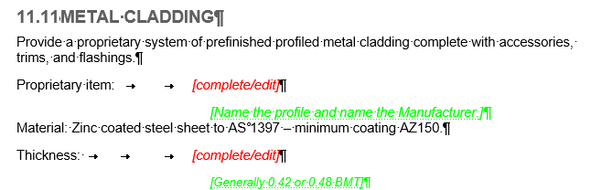
USING DIPL WORKSECTION TEMPLATES
The following is a step-by-step guide on how to edit a specification from a worksection template:
  Identify clauses not required: Delete unnecessary clauses from the worksections. Highlight clauses you are not sure about and leave until later.
  Identify subclauses not required: Delete unnecessary subclauses from the worksection. Highlight subclauses you are not sure about and leave until later.
  Identify paragraphs not required: Delete unnecessary paragraphs. Refer to the hidden guide notes.
  Complete the write-in options: Complete the options, [complete/edit] prompts and schedules.
  Add new material: Add original material not captured in the worksection templates.

Slide 34
USING DIPL WORKSECTION TEMPLATES
  Edit standard text: Edit standard worksection text where it conflicts with project requirements, the drawings, completed prompts, or with added new material.
  Check cross-references: Check all cross-references in the project specification to other worksections, standards, referenced documents, and contract documents. Make sure that cross-referenced material has not been accidentally deleted.
  Proofread: Check the format, Remove all guide notes, populate Hold Points and Witness Points, and update Table of Contents.
  We maintain the specifications but the templates might not cover all technical requirements and we are not experts in all technical areas. We require FEEDBACK and COMMENTS from YOU to improve our specification for future use.
F
E
E
D
B
A
C
K

Slide 35
USING DIPL WORKSECTION TEMPLATES
PROJECT OFFICER FEEDBACK

Slide 36
USING DIPL WORKSECTION TEMPLATES
PROJECT OFFICER FEEDBACK

Slide 37
USING DIPL WORKSECTION TEMPLATES
PROJECT OFFICER FEEDBACK

Slide 38
USING DIPL WORKSECTION TEMPLATES
PROJECT OFFICER FEEDBACK

Slide 39
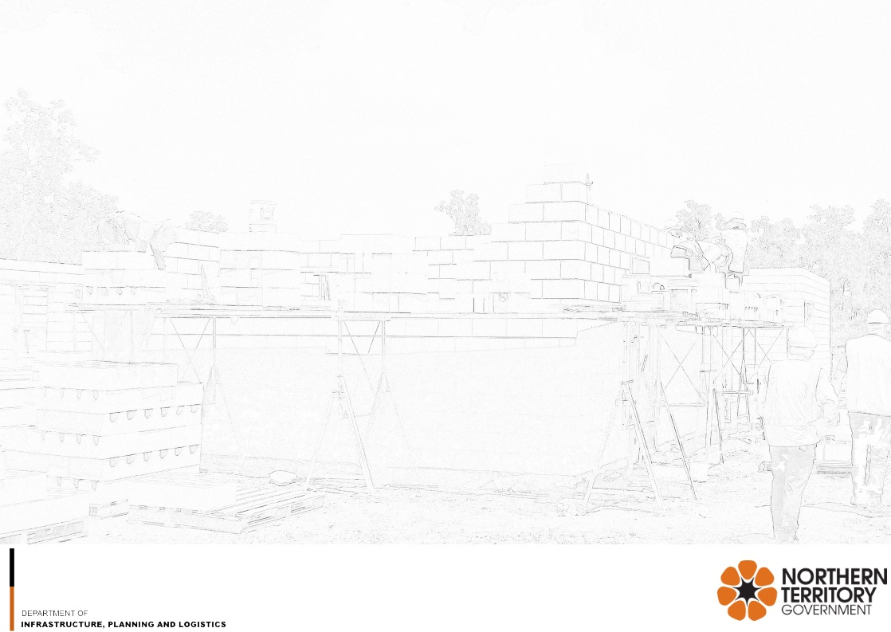


RULES AND WRITING TIPS
Our communications need to be unambiguous, easily understood, and difficult to misinterpret.
RULES
BE CONCISE
A good specification is clear, concise and easily understood.
  Use plain English and basic terminology to convey the required information.
  Minimise alternatives and specify wanted results by using as few words as possible.
  Provide clear instructions.
  Provide specific directions, not suggestions, explanations or reasons.
  Do not include redundant information.
Ask yourself: Is it understandable, clear, simple and not ambiguous?

Slide 40

RULES AND WRITING TIPS
RULES
BE PRECISE
  Check source documents to ensure you use the correct words, phrases and terms.
  Use mandating terminology and avoid vague and ambiguous text.
  Be consistent in word use and phrase the same word throughout the document if the meaning is the same.
  Be specific: redundant information will reduce clarity.
BE UP TO DATE
Only use current information.
  Confirm dates and References.
  Old can be current. Some Australian Standards dating back to the 1970’s have never been replaced.
  Check source documents for updated information.
  Use the latest TDO generated worksection templates.

Slide 41

RULES AND WRITING TIPS
RULES
DO NOT REPEAT
Decide what information is to be given in which documents early on in the project.
  Give that information once only. By showing information only once in the documents, if a change is made to one item, only one change needs to be made to the documents.
  If information is in the specification do not show it on the drawings.
  Keep notes on drawings to a minimum if a written specification is produced.
  Minimising repetition will minimise conflict.
DO NOT CONTRADICT
Ensure information in the various project documents is consistent.
  Cross reference, check and review all documents, if possible review by a third party.
  Delete redundant information which can contradict.
  State an order of precedence if required.
Ask yourself: Does the specification complement the drawings or other supplementary documents?

Slide 42

RULES AND WRITING TIPS
RULES
CO-ORDINATE
Inform all people contributing to the documentation what decisions were made in relation to the project.
  Update the project team on the necessary amendments.
  Decide what information will be shown where.
Co-ordination means:
  Direction.
  Organisation.
  Delegation.
Ask yourself: How will the information be co-ordinated and shared?
THE GOLDEN RULE
Interpret each rule as if followed by “unless context and common sense dictate otherwise.” Do not follow a rule if clarity is reduced.
This is the Golden RULE.

Slide 43
RULES AND WRITING TIPS
WRITING TIPS
Shall: Is indicative of a mandatory requirement unless the context clearly indicates otherwise.
Should or may: Indicates a recommendation (non-mandatory). It is best to avoid them.
By others: Use the words “by others” in a Project Specification to mean that it is not required in that contract.
Do not use the words “by others” to mean “by another trade” within that contract. Project specifications are a set of instructions to the Contractor. The Contractor will determine the tasks assigned to the trades.
Unless otherwise specified: Do not use the phrase “unless otherwise specified” as it requires the reader to scan the whole Specification to check for any exceptions. Specify the general requirements and clearly identify any exceptions in the relevant section of the Specification.

Slide 44

RULES AND WRITING TIPS
WRITING TIPS
Or equivalent: Do not use the words “or equivalent” or “or equal” as this is covered in the Proprietary Items clause in the Conditions of Contract.
As appropriate: Do not use “as appropriate”. Who decides what is appropriate?
Superintendent: Refer only to the Superintendent (or to the Principal in specific cases) and not to the Superintendent’s representative, the Engineer, the Architect or the Supervisor.
The Contract is administered by the Superintendent who will seek the assistance of the relevant Specialists when required.

Slide 45
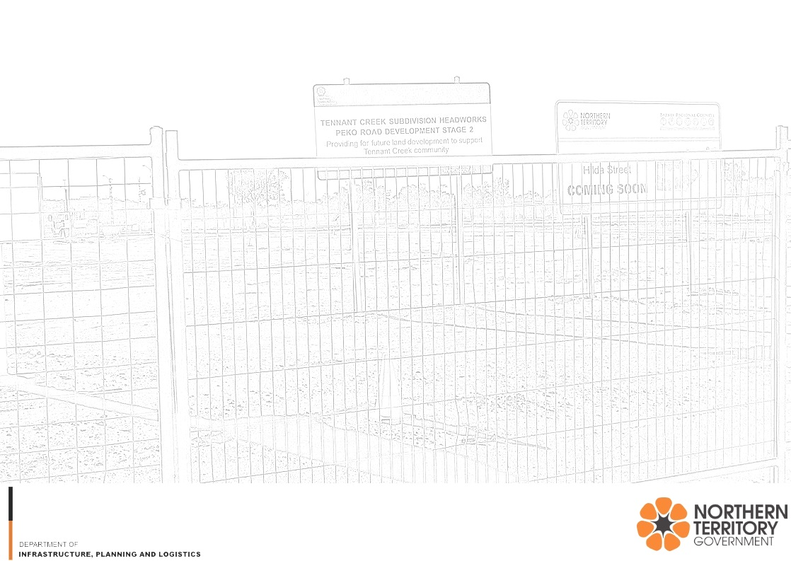

AMBIGUITY
Ambiguity: The quality of being open to more than one interpretation.
Specifications need to be unambiguous, easily understood, and difficult to misinterpret.
Example 1: All surfaces shall be painted white to increase reflectivity.
Does it mean?
  Paint all surfaces white?
  Determine which surfaces have lower reflectivity than white paint, and paint them white?
The intent was to paint all surfaces white. The contractor interpreted the clause differently.

Slide 46

AMBIGUITY
Ambiguity: The quality of being open to more than one interpretation.
Example 2: Prior to accepting software or documentation developed by subcontractors, the contractor shall evaluate them for completeness, technical adequacy, and compliance with the contract.
What is to be evaluated? Is it the deliverables, or is it the subcontractors?
Example 3: The existing demountable will be relocated to an alternative location on the site within 50 m of the present location. Reconnect the demountable to power, water and sewerage services.
The contractor arrived on site and asked “When is the demountable going to be relocated so that I can reconnect the services?”

Slide 47
AMBIGUITY
Ambiguity: The quality of being open to more than one interpretation.
CONTEXTUAL AMBIGUITY
Example 4: The flange shall be fastened by three round-head screws, three flathead screws, and three fillister-head screws all of grade eight.
Means you’ve specified that three of the screws must be of grade eight.
The flange shall be fastened by three round-head screws, three flathead screws, and three fillister-head screws, all of grade eight.
Means you’ve specified all nine of the screws must be of grade eight.
Example 5: The flange shall be fastened by nuts and bolts of stainless steel.
Means you’ve specified that the bolts only are to be stainless steel.
The flange shall be fastened by nuts and bolts, of stainless steel.
Means you’ve specified that the nuts and bolts are to be stainless steel.

Slide 48

TOOLS AND REFERENCE MATERIAL
TECHNICAL SPECIFICATIONS WEBSITE
Information accessible via DIPL Technical Specifications website can assist consultants and project officers prepare specifications and contract documents.
Specification Writing Guidance Booklet is a compilation of articles created after research into Specification writing. Most of the articles are from sources outside Australia, but the selected sections are relevant to the Australian context.
https://dipl.nt.gov.au/infrastructure/technical-standards-guidelines-and-specifications/technical-specifications
Roads webpage. Master specifications, standard specification reference books, and supplementary documents all available for download.
https://dipl.nt.gov.au/infrastructure/technical-standards-guidelines-and-specifications/technical-specifications/roads
Buildings webpage. Master specifications, standard specification reference books, and supplementary documents all available for download.
https://dipl.nt.gov.au/infrastructure/technical-standards-guidelines-and-specifications/technical-specifications/buildings
Notes:
Go to webpage.

Slide 49
TOOLS AND REFERENCE MATERIAL
NATSPEC
NATSPEC is a national not-for-profit organisation, owned by Government and industry, whose objective is to improve the construction quality and productivity of the built environment through leadership of information.
NATSPEC TECHnotes
https://www.natspec.com.au/resources/technotes
NATSPEC TECHreports
https://www.natspec.com.au/resources/techreport
Note: You will need to sign up (free) to be able to download NATSPEC technical resources.
Notes:
Go to webpage.

Slide 50
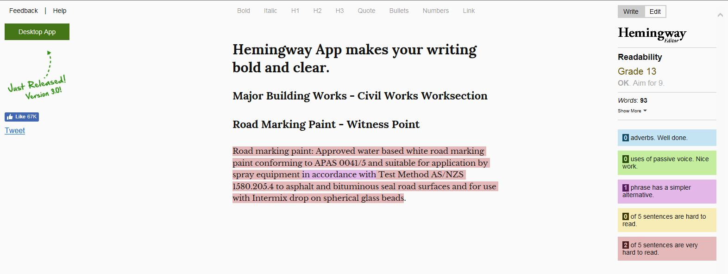
TOOLS AND REFERENCE MATERIAL
HEMINGWAY APP
http://www.hemingwayapp.com/
Hemingway App can be used to make your writing bold and clear. The app highlights lengthy, complex sentences and common errors.
Notes:
Go to webpage.

Slide 51
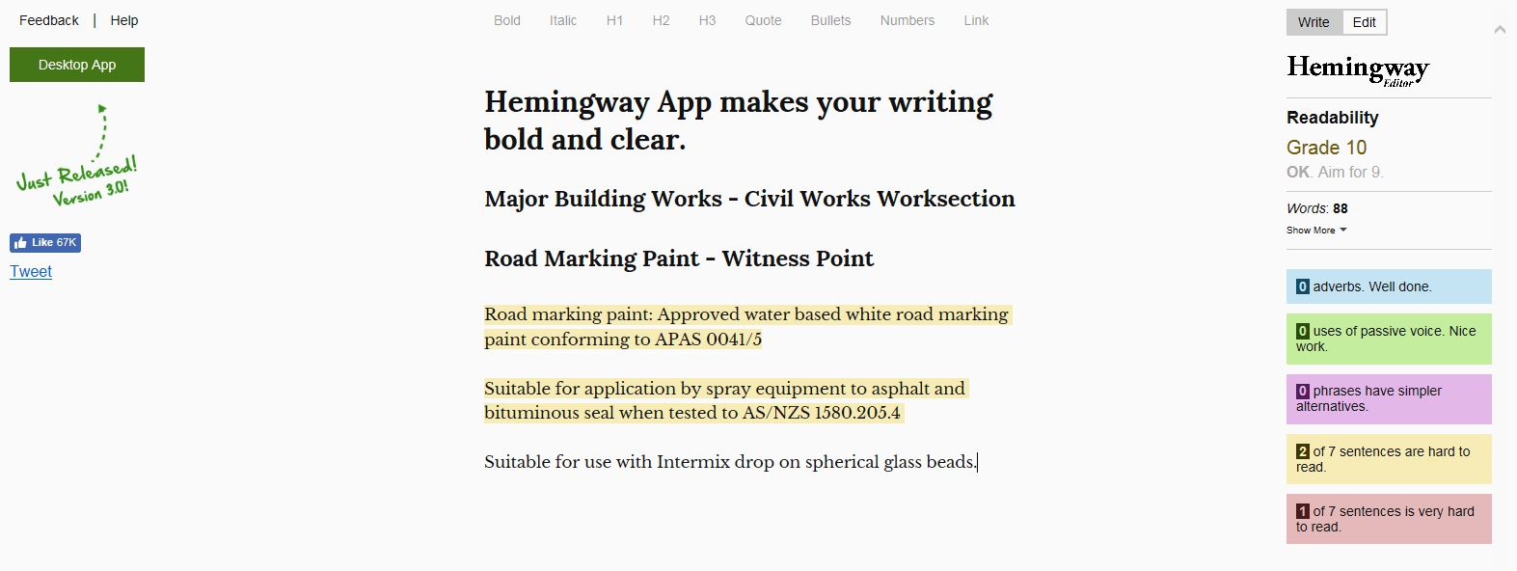
TOOLS AND REFERENCE MATERIAL
HEMINGWAY APP
http://www.hemingwayapp.com/

Slide 52
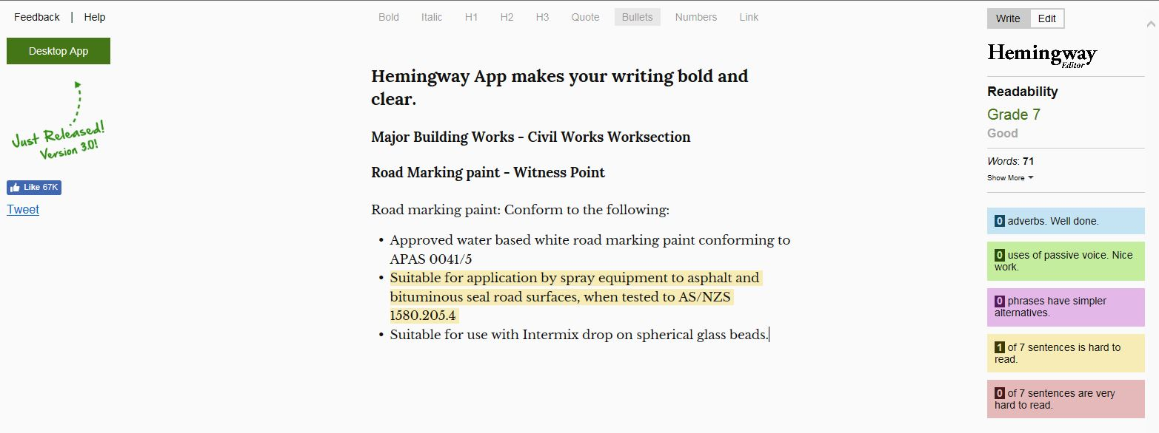
TOOLS AND REFERENCE MATERIAL
HEMINGWAY APP
http://www.hemingwayapp.com/

Slide 53

HOLD POINTS AND WITNESS POINTS
Hold Points and Witness Points are construction stages which may need additional inspection, verification and documentation.
HOLD POINT
A Hold Point is a mandatory verification point beyond which a work process cannot proceed without authorisation by the Superintendent.
Hold Points are usually assigned to those critical aspects of the work that cannot be inspected or corrected at a later stage.
The relevant work cannot proceed until the Superintendentis able to verify the quality of the completed work and releases the Hold Point.
Use Hold Points sparingly as each potentially affects project duration and cost.

Slide 54
HOLD POINTS AND WITNESS POINTS
WITNESS POINT
A Witness Point is an identified point in the work process where the Superintendent may review, witness, inspect or undertake tests on any component, method or process of works.
The contractor is required to notify the Superintendent who may or may not take the opportunity. The subsequent activity however, may proceed.

Slide 55

BIBLIOGRAPHY
REFERENCE
NATSPEC https://www.natspec.com.au/
Developing Specifications - Queensland Government.
Guide to Writing Specifications, Masterspec, New Zealand.
Specification and Writing Style Manual, Oregon Department of Transportation, USA.
Specification Style Guide, California Department of Transportation, USA.
A Guide to Writing Specifications, Los Angeles Unified School District, USA.
Writing Better Technical Specifications, G Covey & G Faber, Somerset, Tasmania.
Hemingway app http://www.hemingwayapp.com/

Slide 56

QUESTIONS?

